Slide 1



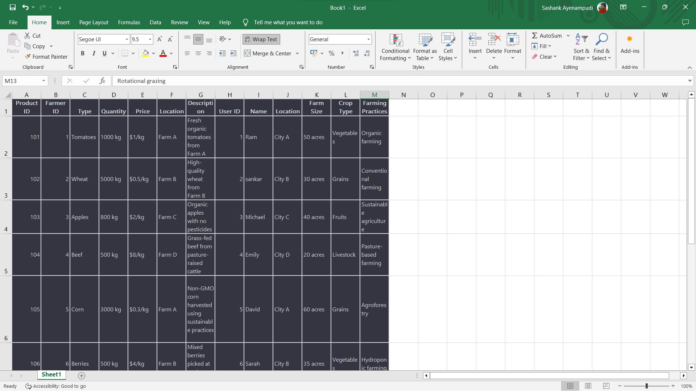
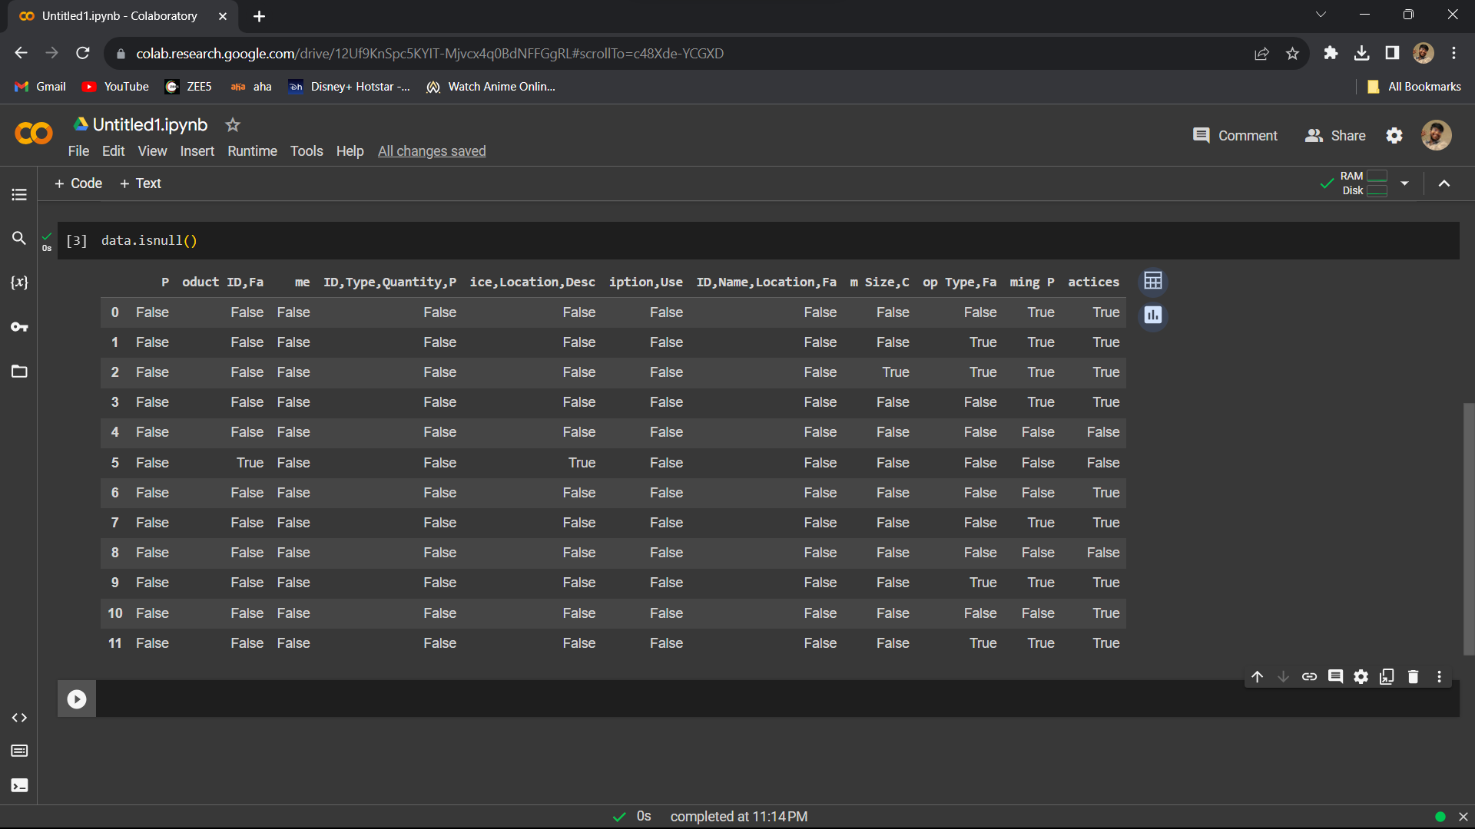


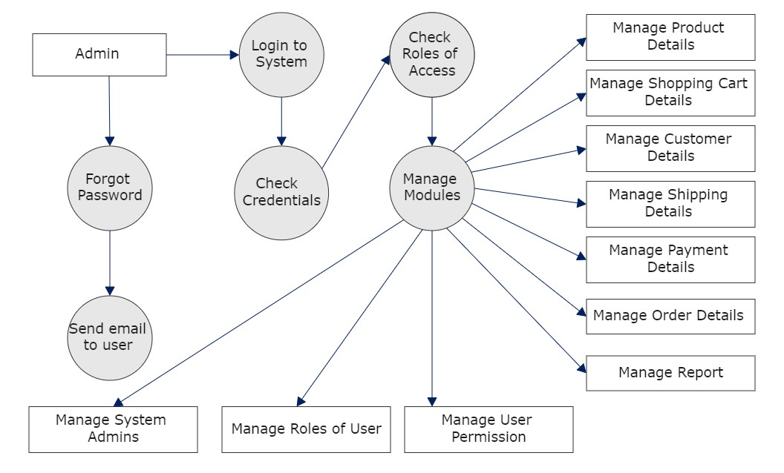
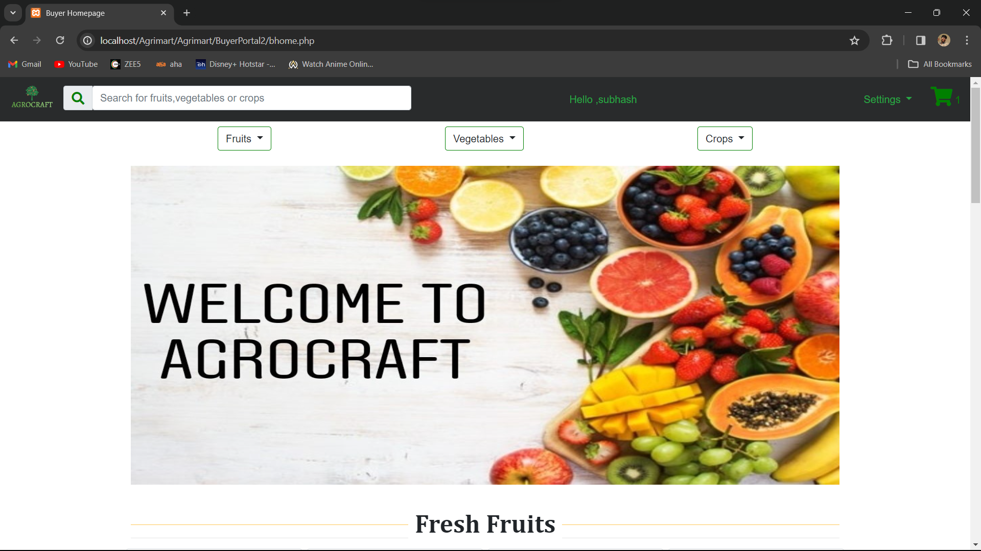
EFFICIENT AGRICULTURAL TRANSACTIONS USING CLOUD COMPUTING
Department of Computer Science & Engineering
School of Computing
10214CS602-MINOR PROJECT-II
WINTER SEMESTER 2023-2024
ABSTRACT
Introduction
Proposed System
Collection and processing of data
Developing a web application for agricultural marketing to connect farmers and buyers, facilitating the seamless listing and purchase of agricultural products while streamlining order management and promoting a transparent marketplace.
Facilitate the exchange of agricultural products by creating a user-friendly web platform that connects farmers with potential buyers, streamlining the marketing process, and fostering transparency and efficiency in agricultural trade.
Utilize modern web development technologies and frameworks to create a robust platform with distinct user roles for farmers and buyers, incorporating features such as intuitive profile management, detailed product listings.,
The result is a successful digital ecosystem that simplifies and enhances the trading process in the agricultural sector, fostering collaboration and accessibility for both farmers and buyers.
Develop a comprehensive web application tailored to facilitate agricultural marketing. Primarily targeting farmers and buyers within the agricultural supply chain.
Advanced search functionality for buyers to find specific products efficiently. Streamlined processes for placing, tracking, and managing orders. A user-friendly digital ecosystem that connects stakeholders seamlessly. Improved accessibility to agricultural products for both farmers and buyers.
Enhanced market transparency and streamlined trade processes. Simplify and enhance the agricultural product trading process. Foster transparency, efficiency, and collaboration in the agricultural sector.
Leveraging modern web development technologies and frameworks. Emphasis on scalability, security, and responsiveness for optimal user experience.
Through modern web technologies, the application aims to enhance transparency, efficiency, and collaboration within the agricultural sector, ultimately fostering a more accessible and seamless marketplace for all people involved.
In contrast, the proposed agricultural marketing website, developed with a simple PHP backend, introduces a transformative shift by directly connecting farmers with consumers. By leveraging dynamic content generation, the platform ensures real-time market updates, product listings, and streamlined communication channels. The absence of complex machine learning algorithms enhances system simplicity and ease of maintenance, while the user-friendly interface contributes to a seamless and efficient user experience. This proposed system addresses the shortcomings of the existing model, fostering transparency, accessibility, and direct interaction within the agricultural marketplace. Furthermore, the proposed system incorporates a robust market research component, leveraging data analytics to provide farmers with real-time market insights. This addresses the information asymmetry prevalent in the existing system, allowing farmers to make informed decisions about pricing and product offerings. Additionally, the system emphasizes value addition and branding strategies, enabling farmers to enhance the competitiveness of their products. Overall, the proposed agricultural marketing system seeks to bridge existing gaps, fostering a more direct and transparent relationship between farmers and consumers.
Collecting the dataset which contains of the product Id, farmer id, type, quantity, price, location, user id, name, location, farm size, crop type.
A user-friendly interface facilitates farmers in inputting crucial information such as crop types, quantities, and market preferences. The data is systematically stored in a MySQL database, employing normalization techniques to maintain integrity and streamline retrieval.
Automated data validation protocols contribute to data reliability, supporting informed decision-making for both farmers and market participants. This meticulous data collection and processing framework form the backbone of the website, empowering stakeholders with valuable insights for effective agricultural marketing strategies.
Add the Process flow/ Flow Chart / Architecture
Collected Data
Processing of Data
Conclusion
In conclusion, the survey highlights the multifaceted challenges in our regional agricultural marketing, encompassing limited market access, price volatility, quality control issues, and food safety concerns. These hurdles impact both producers and consumers, casting a shadow on the sustainability of the current system. However, the findings also unveil a promising path forward. By implementing recommended strategies, including infrastructure investments, enhanced market information systems, sustainable practices, and the integration of digital technologies, we can effectively address these challenges. Strengthening regulatory frameworks, supporting farmer cooperatives, and launching consumer education campaigns are integral components of this transformative journey.
Output-1
Figure 1. Architecture Diagram
TEAM MEMBER DETAILS
Methodologies
STUDENT1 20051/S.V.N.S.TIRUMALA DEVI
STUDENT2 21190/Y.YOGANAND
STUDENT3 19771/B.GNANESWAR
STUDENT1 9705882779
STUDENT2 7032757176
STUDENT3 7285909522
STUDENT1 vtu20051@veltech.edu.in
STUDENT2 vtu21190@veltech.edu.in
STUDENT3 vtu19771@veltech.edu.in
The development methodology for the Agricultural Marketing website embraces an Agile framework, ensuring flexibility and iterative progress. User-Centered Design principles guide the intuitive interface, while PHP facilitates dynamic content generation and interaction with the MySQL database. Responsive web design using HTML5, CSS3, and JavaScript, alongside Git version control and continuous integration, contributes to a secure, scalable, and collaborative development process. The website prioritizes user experience, security, and adaptability to evolving agricultural needs, fostering a modern and efficient platform. The back end leverages PHP scripting and MySQL database management to ensure efficient data handling. Embracing version control with Git and following security best practices, the website maintains a robust, secure, and well-organized codebase. Continuous integration and deployment streamline development workflows, while future scalability is considered, allowing for seamless expansion and integration of new features to meet evolving agricultural market demands.
ACKNOWLEDGEMENT
Dr.S.Saravanan,M.E, Ph.D.,
7502508311
Output-2

